Slide 1
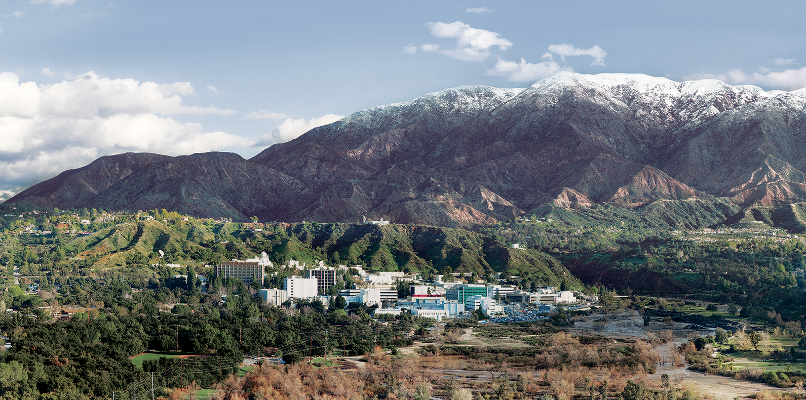
5. Linear Mixture Models
Dr. David R. Thompson
Jet Propulsion Laboratory, Imaging Spectroscopy Group
July 20, 2019

Slide 2
Goals for this module
Understand the difference between linear and nonlinear mixing
Apply mixture models to synthesize mixed-pixel spectra
Unmix spectra with a spectral library

Slide 3
Linear and Non-linear subspaces
Q: When does linear dimensionality reduction work well for our datasets?
A: When spectra “live” in a mostly-linear subspace.
Credit: wikimedia

Slide 4
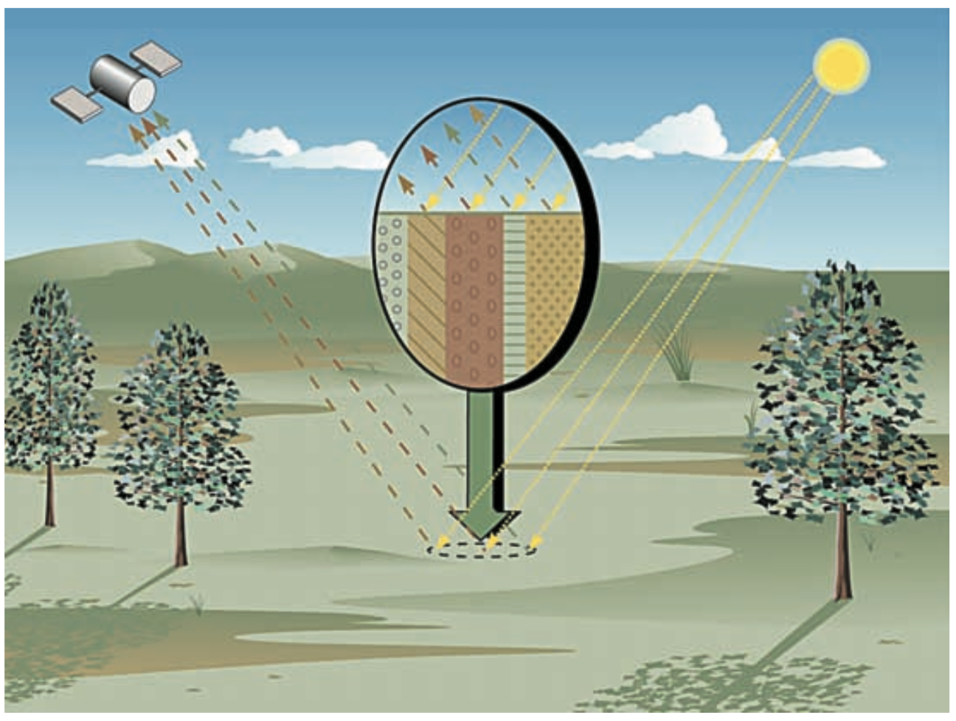
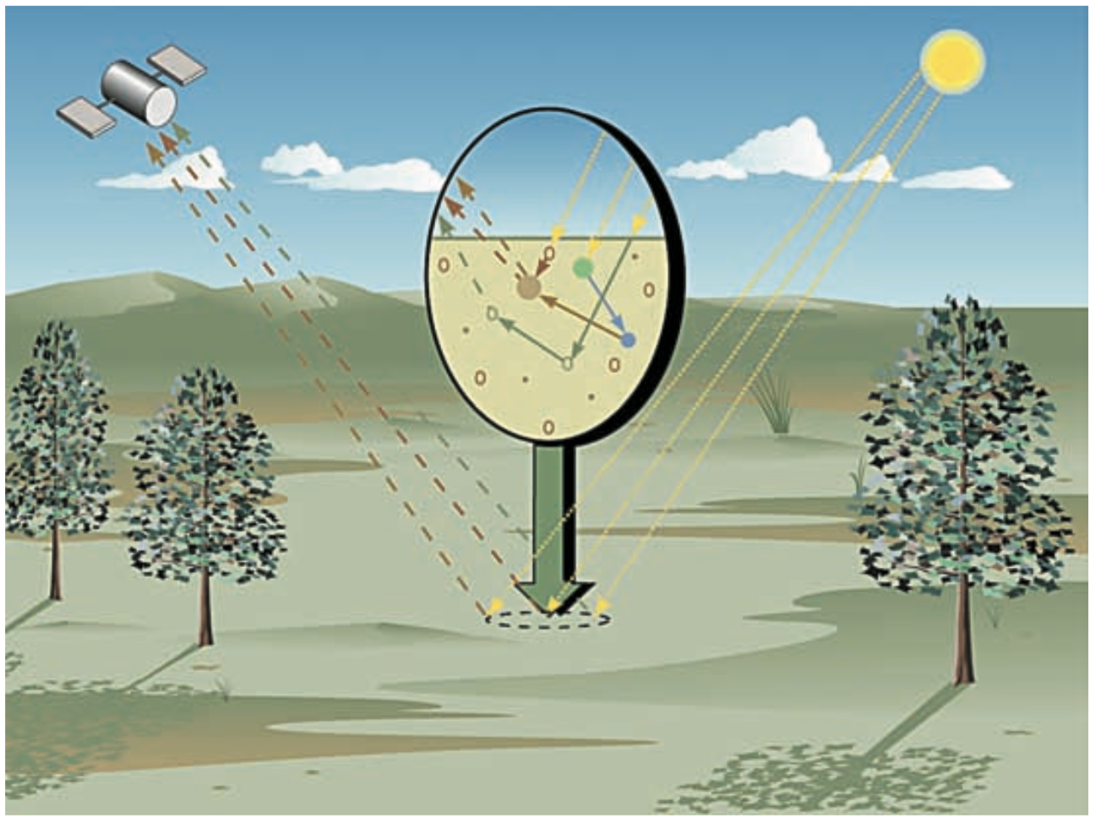
Linear vs. nonlinear mixtures of spectra
Linear “geographic” or “areal” mixing is where spectra combine in in geographic proportion, a “checkerboard model” that is effective for many applications.
Nonlinear “intimate” mixing is a combination of scattering and reflection/absorption events. Minerals, tree canopies, urban environments, etc.
Credit: Keshava and Mustard, IEEE Signal Proc. Mag., 2002

Slide 5
Subpixel modeling: Gather a library of spectra
Could come from locations in the scene, prior observations, or field studies.
The panels at right show an example library formed of green vegetation (GV), soil, and nonphotosynthetic vegetation (NPV) spectra.

Slide 6
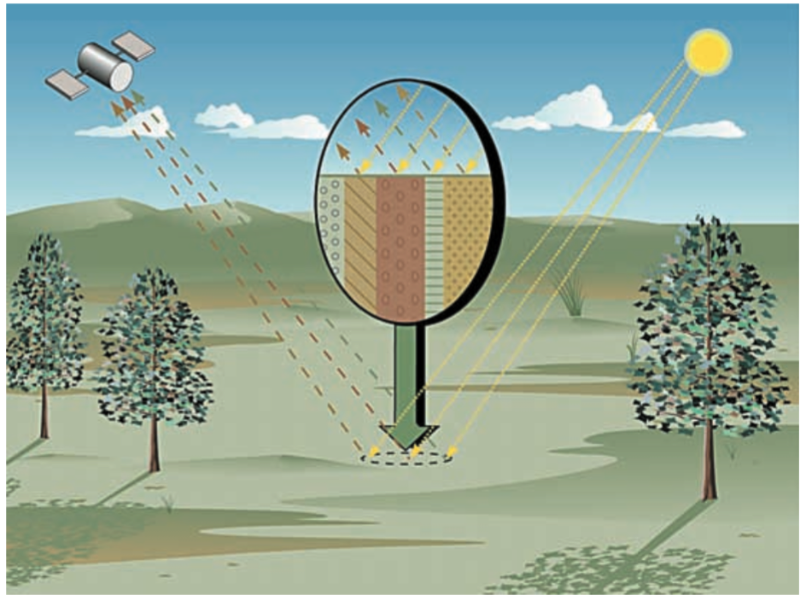
Subpixel modeling
We assume a geographic mixture model where all pixels are linear combinations of library spectra.
r(λ) = Σ_{i} a_{i}(λ) b_{i}
Observed reflectance
Library spectrum
Mixing fraction
It is typical to force all b_{i} to be nonnegative. “Sparsity” (i.e. lots of zero entries) may be favored.
Geographic mixing (Linear model)
[Keshava and Mustard, IEEE 2002]

Slide 7
Multiple Endmember Spectral Mixture Analysis
A nonnegative least squares problem (all b_{i} ≥ 0)
MESMA (Roberts et al., RSE 2003) finds the optimal compact combination of library endmembers to reproduce observations
Minimizes per-channel RMSE
Observed reflectance
in wavelength j
Library spectrum
Mixing fraction
Measurement noise

Slide 8
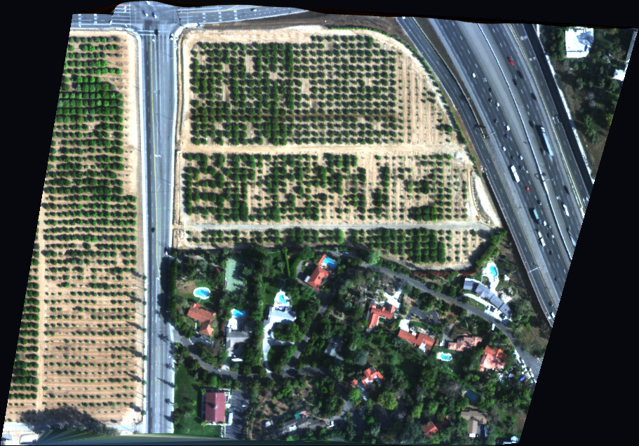
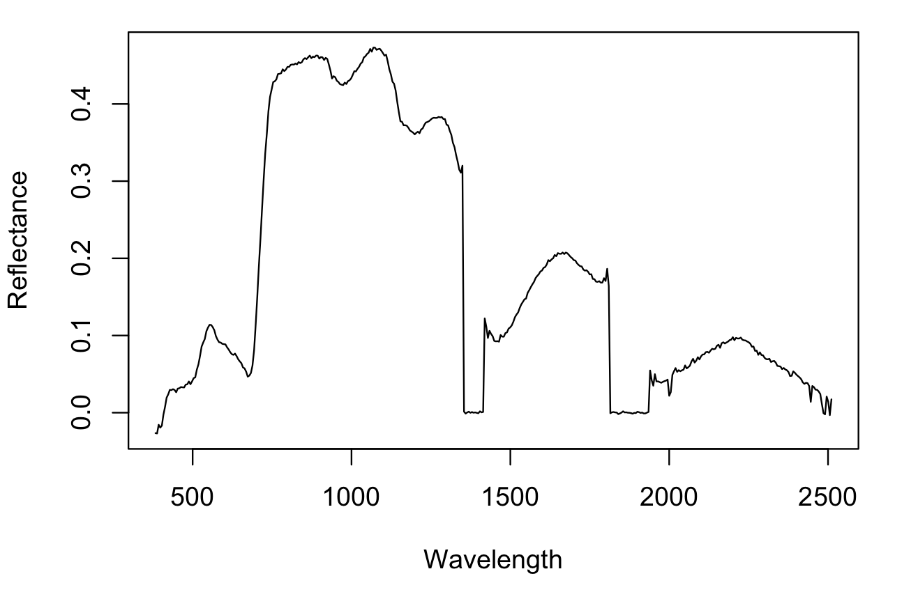
Example of geographic mixing models
Surface reflectance in Visible ShortWave InfraRed (VSWIR), acquired by a Next Generation Imaging Spectrometer
Chlorophyll
Liquid Water absorption
Water vapor absorption (remember?)

Slide 9
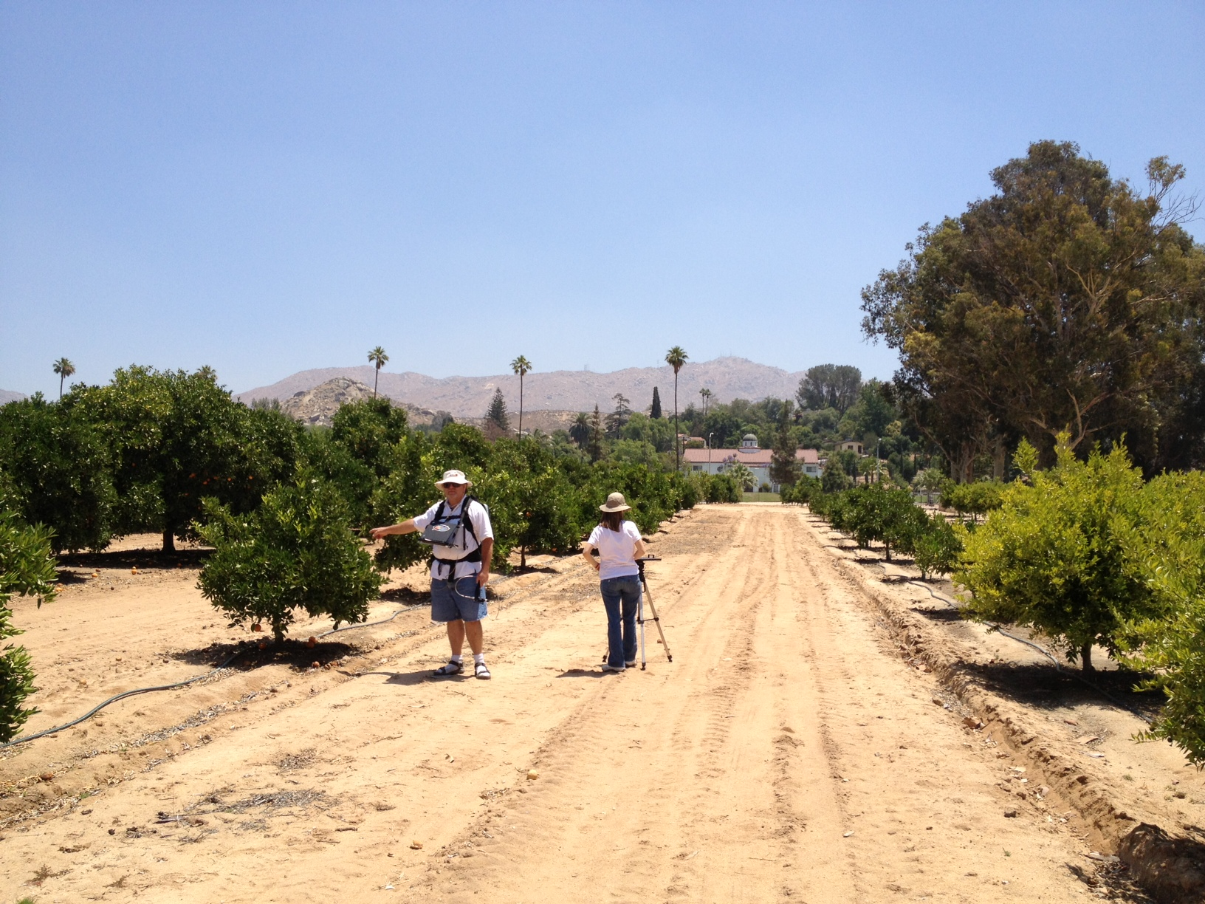
What surfaces are evident?
Leaves
Shade
Dirt

Slide 10
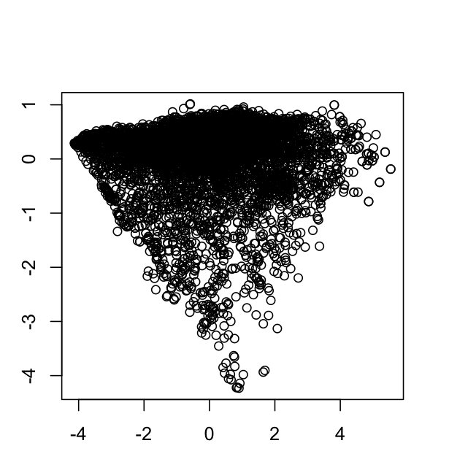
Orchard example
The projection onto the first two principal components reveals a “simplex” of linear mixtures comprised of shade, soil, and vegetation.
green
vegetation
PCA Projection
shade
soil

Slide 11
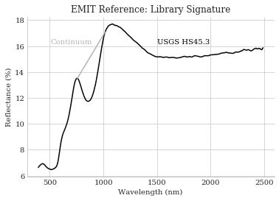
Continuum-absorption models
Another common model for reflectance spectra is to treat the reflectance as a linear or polynomial ”continuum,” attenuated by one or more absorption features.
Continuum removal involves dividing by the linear continuum, transforming the absorption into a feature that is more invariant and insensitive to the substrate underneath.
Here, the library holds the absorption signatures. A fitting algorithm matches them to the continuum-removed spectra.
The panel at right shows a Hematite absorption feature from the USGS spectral library. The continuum appears in grey.

Slide 12
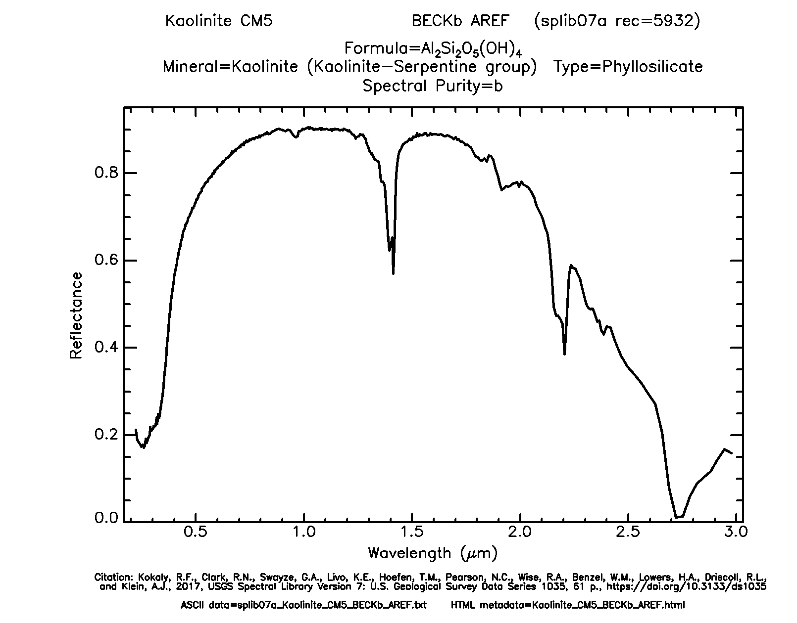
Placing the continuum is an art!
Absorptions
Continuum
?

Slide 13
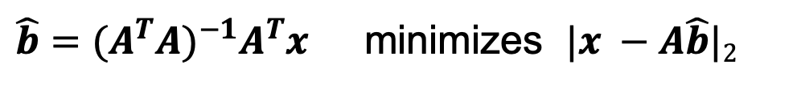
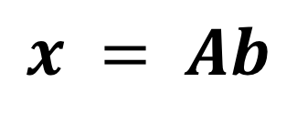
Inversion options
$$x = Ab$$
Standard least squares minimization:
Nonnegative least squares (Lawson/Hansen algorithm, iterative):
Measured spectrum
A library matrix where columns are spectra
Vector of mixing coefficients
$\hat{b}={(A^{T}A)}^{−1}A^{T}x$ minimizes $|x −A\hat{b}|2$
$\hat{b}=f\left(A,x\right)$ minimizes $\left|x −A\hat{b}\right|2 S.T. \hat{b}≥0$

Slide 15
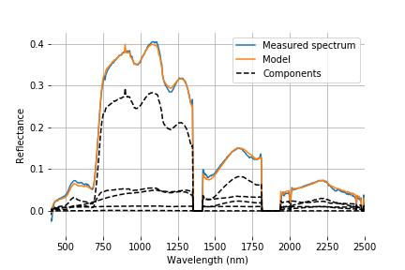
Exercise 5: Spectral unmixing
Objective: Unmix the list of spectra in the citrus orchard overflight.
Plot the model fits and nonzero component spectra for some representative examples. The right panel shows spectrum #1000.
Extra credit: interpret your endmembers, and find the mixture fractions of vegetation, nonphotosynthetic vegetation, soil and shade.

